Slide 2
Proverif
secrecy
correspondence
observational equivalence(indistinguishability)

Slide 3
bound names: in a process
free names: known to all processes
variables

Slide 4
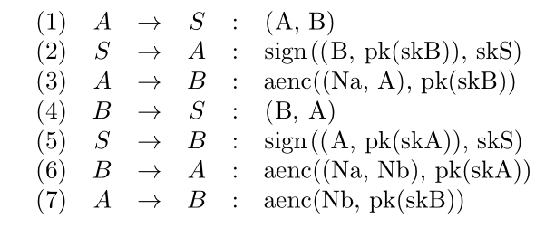
Needham-Shroeder public key protocol

Slide 5
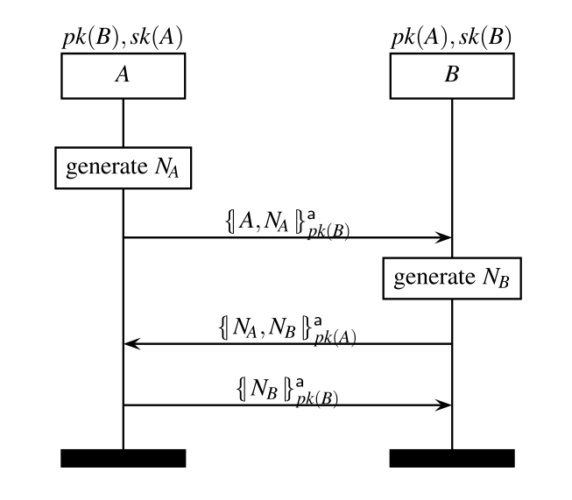

Needham-Shroeder public key
Simplified Version

Slide 6

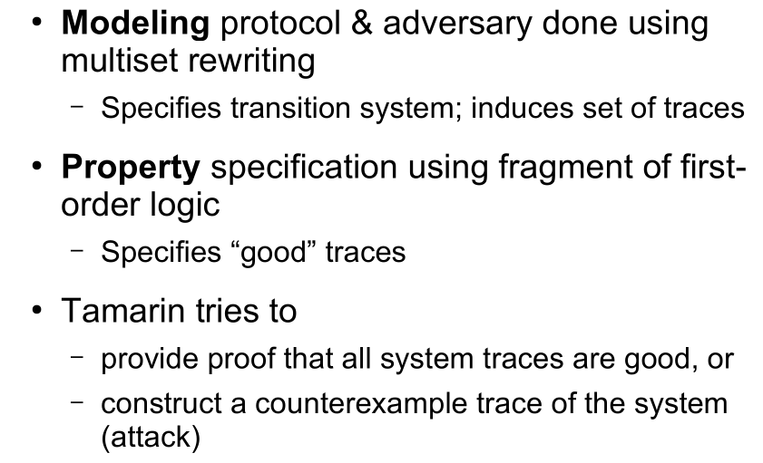
Tamarin

Slide 7
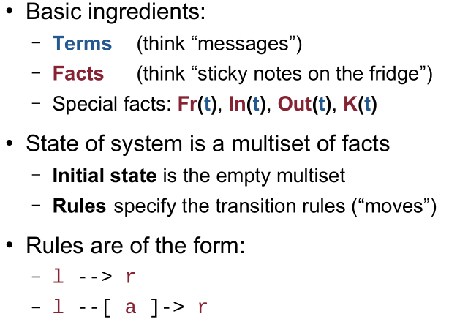
Modeling in Tamarin
the predicate on terms
sent out the message t on the public channel

Slide 8
Cryptographic Messages

Slide 9
Syntax
a Tamarin input file consists of:
Comments( C-like, single line: //, multiline: /* */)
starts with theory followed by the theory’s name
the keyword begin
cryptographic primitives declarations (the protocol process uses)
multiset rewriting rules declarations (modeling the protocol)
properties declarations ( lemmas to be proven)
the keyword end

Slide 10
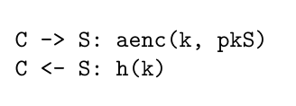
Example

Slide 11
Example
Begining and Cryptographic primitives

Slide 12
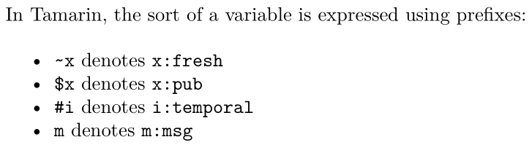
Example
Multiset Rewriting Rules declarations
i. first, generate a fresh name ~ltk, which is the new private key(Long-term key)
ii. non-deterministically choose a public name A for the agent for whom we are generating the key-pair.
iii. Afterward, generate the fact !Ltk($A, ~ltk) (the exclamation mark ! denotes that the fact is persistent).which denotes the association between agent A and its private key ~ltk,
iv. generate the fact !Pk($A, pk(~ltk)), which associates agent A and its public key pk(~ltk).

Slide 13
Example
Multiset Rewriting Rules declarations
modeling that the adversary can access any public key existing
[ !Ltk] --[LtkReveal(A)]-> [Out] modeling dynamic compromise of long-term key
the action facts is “ --[LtkReveal(A)]->”, showing that the Long-term key of A has been compromised.
action facts shown on the traces, other facts shown in the states

Slide 14

Example
Multiset Rewriting Rules declarations
C1 -> S1: aenc(k, pkS)
C2 <- S1: h(k)

Slide 15
Example
Multiset Rewriting Rules declarations
C1 -> S1: aenc(k, pkS)
C2 <- S1: h(k)
the action facts here is for allowing the formalization of the authentication property for the client , because security properties are defined over traces of the action facts of a protocol execution, using actions fact to record this knowledge.

Slide 16
Example
Properties declarations
Security properties are defined over traces of the action facts of a protocol execution

Slide 17
Example
Properties declarations

Slide 18
Example
Properties declarations

Slide 19
Example
Properties declarations

